Slide 1
ConstructConnect-GT Project
Final Presentation
November 19, 2025
Notes:
Prof. Alexander

Slide 2


Team Members
Business undergraduate students
Computer Science undergraduate students
Computer Science graduate students/ postdocs
Notes:
Prof. Alexander

Slide 3
Task
Test Large Language Models (LLMs) as alternatives to Boolean searches of construction documents for:
Brand mentions
Product specifications
🤔Product type
Focus on the HVAC industry, five top manufacturers:
Trane
Carrier
Daikin
Lennox
York/Johnson Controls
Plus additional identified manufacturers
Notes:
Prof. Alexander

Slide 4
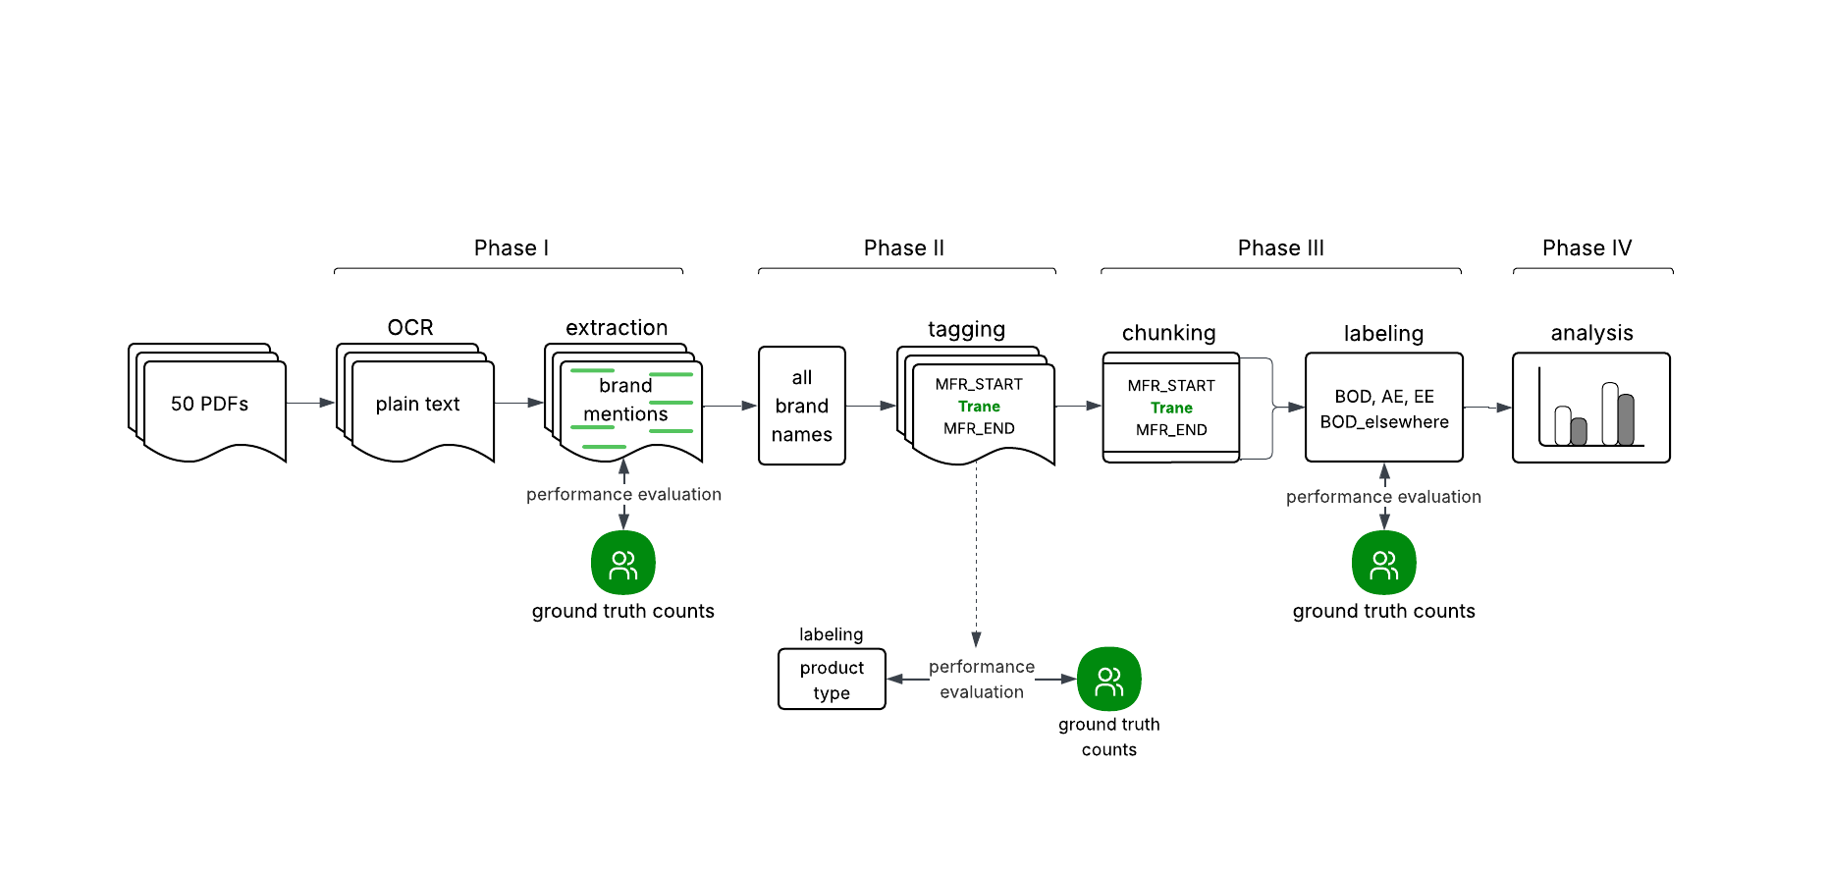
Project Map
Notes:
Prof. Alexander

Slide 5
Phase I
Notes:
Ben

Slide 6
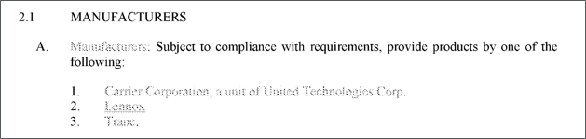
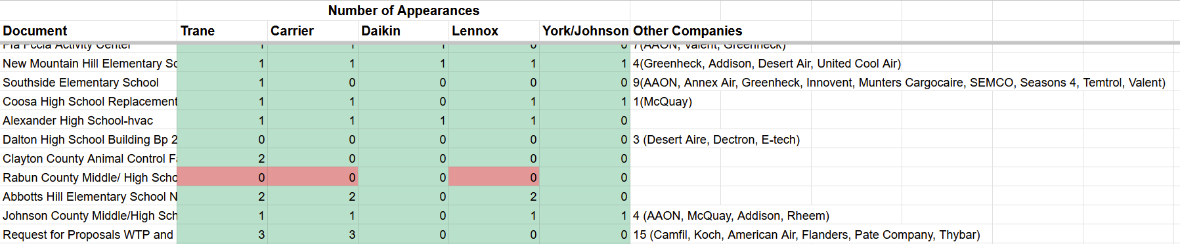
OCR + Brand Name Extraction
Optical Character Recognition
Convert PDFs to plain text
Brand Name Extraction
Claude is horse race winner 🏇🥇
98% accuracy compared to ground truth values
Successfully extracts companies that are not explicitly given in the prompt
Only errors due to OCR issues
Notes:
Ben

Slide 7
Phase II
Notes:
Bratee

Slide 8
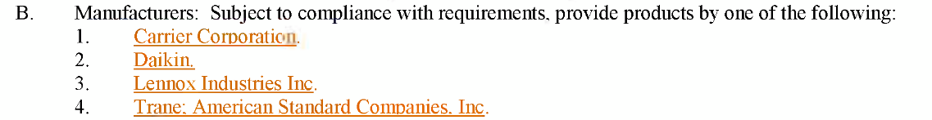
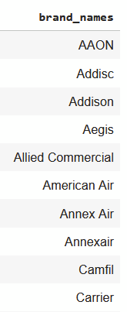
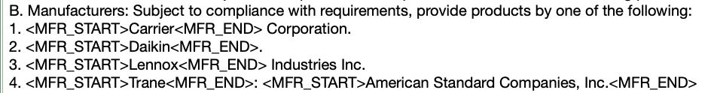
Tagging Brand Names Within Text
1. List of Extracted Brand Names
2. Match with Text
Exact matches
Fuzzy matches (to deal with OCR artifacts) using RapidFuzz library
EX. Name = “Daikin” and text = “Dakain”, >90% accepted as fuzzy match
3. Insert tags
Accounts for varied spelling
Notes:
Bratee:
Here we are tagging the brand names within the text to test different chunking strategies around company names, in order to see what is the most efficient way to query an LLM to give us specifications given the least amount of information.
As an input to this process, we take a list of all the brand names we were able to find in the 50 documents with the help of the research team.
Using REGEX, we perform exact matching and fuzzy matching. For fuzzy matching, any words that had a 90% partial ratio according to the RapidFuzz Python Library was accepted, and this is a highly optimized library made for larger datasets. Any fuzzy matches was also replaced by the canonical version of the name, as to not confuse the LLM when it reads around the tags.
Then, it simply puts the tag around the name for chunking.

Slide 9
Phase III
Notes:
Harsh & Soham

Slide 10
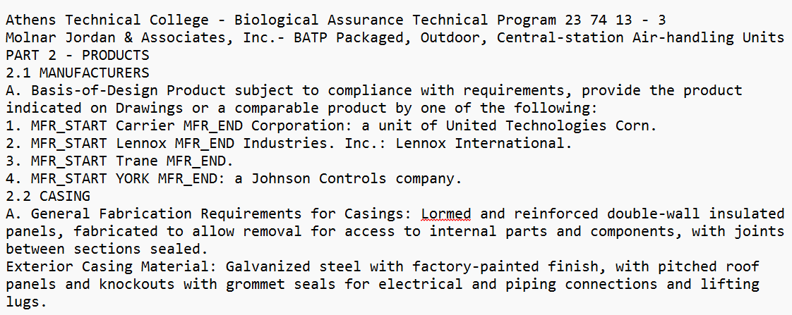
Chunking
Chunking
Extract context window of +/- 300 words around each tagged brand name
Removes extraneous “noise” from longer document
Notes:
Soham

Slide 11
Product Specification Labeling
Product Specification Labeling
Extract product specification from chunks for each brand name
- Basis of Design elsewhere - Approved Equal
- Basis of Design - Explicitly Excluded
Claude and GPT5 are tied in horse race 🏇🥇
100% accuracy compared to ground truth values
Notes:
Harsh
Make sure you can fully explain the different labels that we extracted from the chunks:
BOD elsewhere
BOD
AE: note the different language that this includes that the research team uncovered, e.g. approved equal, comparable product, or equal, include but not limited to, one of the following, etc.
EE [no examples among our 50 but we understand that this is possible across the full corpus]

Slide 12
🤔 Product Types
Notes:
Arnav

Slide 13
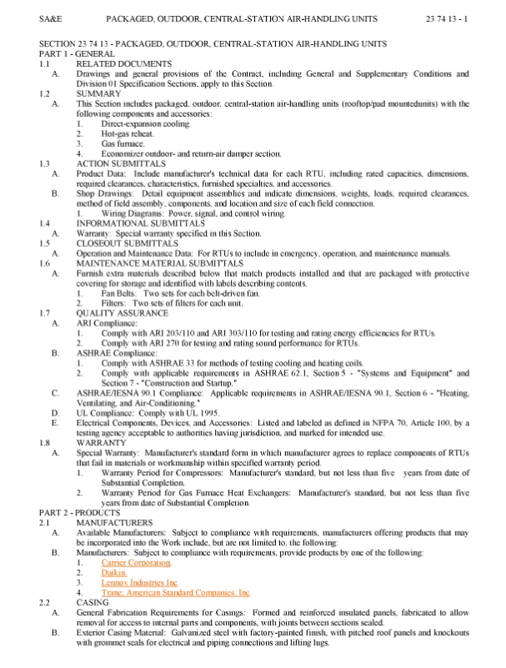
Product Type Labeling
Page header
Approach
Extracted product types from page headers, section headers, and structural patterns.
Intended to capture high-signal product labels embedded in spec formatting.
Outcomes
Strong recall: major product families consistently captured.
Precision unstable: model introduced extra or unrelated product types.
Key Issues
Normalization drift created duplicates.
Section headers misread as product names.
Over-generation and hallucinated product types.
Subtype qualifiers treated as standalone categories.
Interpretation
High-recall but noisy extraction.
LLM over-classified text patterns that weren’t true product types.
May be better to extract only from structured document regions.
Next Steps
Evaluate whether LLMs are overkill compared to simple header extraction.
Section or sub-section header
<< Manufacturers
Notes:
Arnav

Slide 14
Phase IV
Notes:
Adi

Slide 15
Descriptive Statistics
50 documents
26 manufacturers
Documents:
10% Basis of Design elsewhere
10% Basis of Design (1 document has only BOD and no AE)
98% Approved Equal
0% Explicitly Excluded
Notes:
Adi

Slide 16
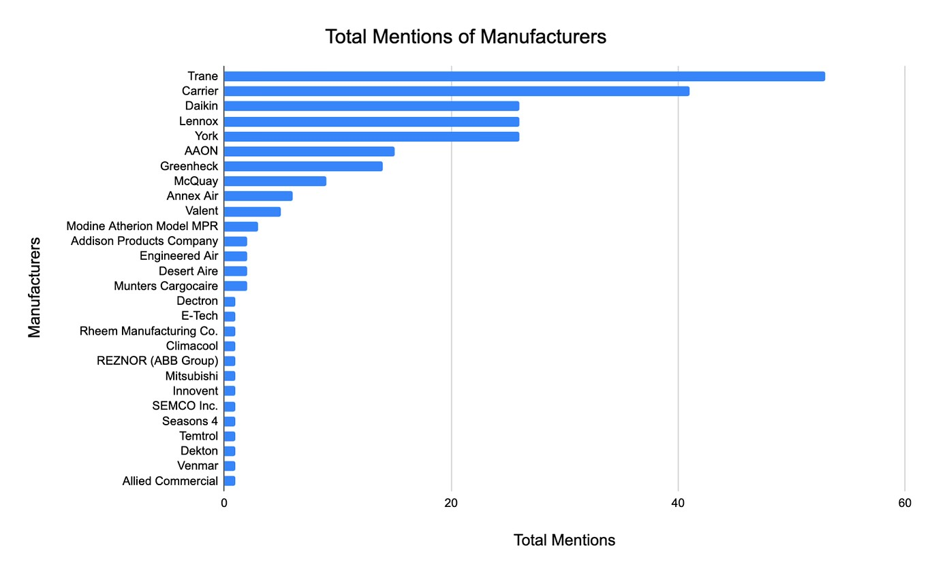
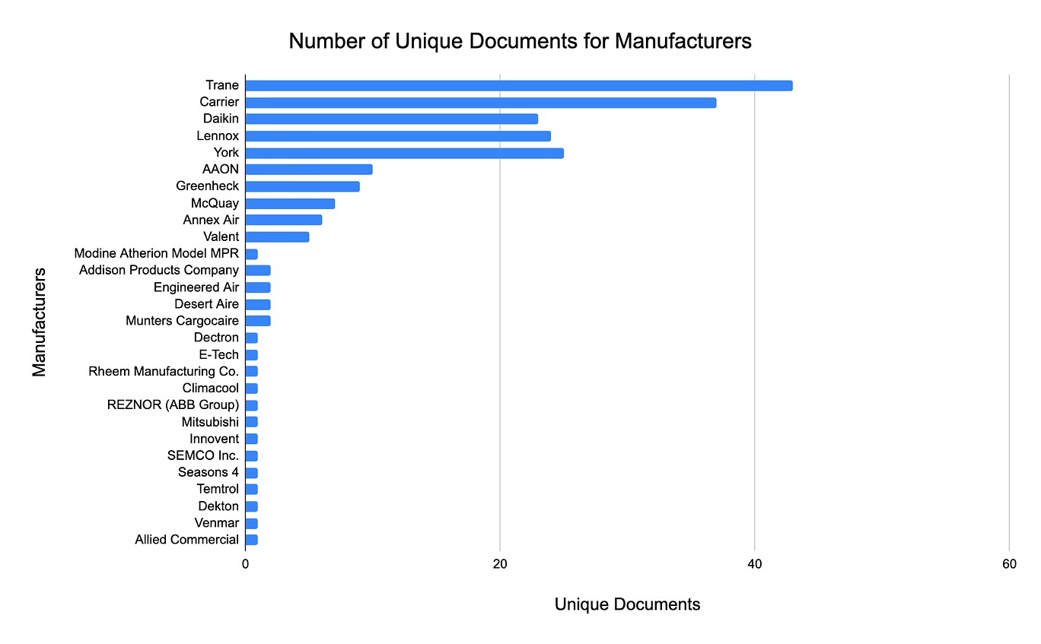
Manufacturer Mentions
Four tiers of manufacturers:
Trane, Carrier
Daikin, Lennox, York
AAON, Greenheck
The rest
Notes:
Akshaj

Slide 17
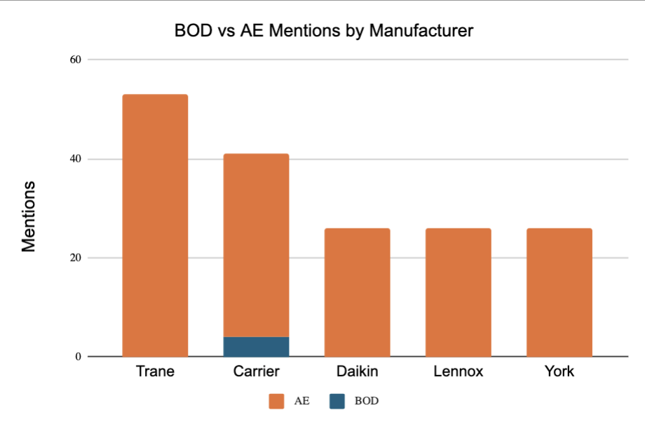
BOD vs. AE Mentions (Top 5)
Only BOD manufacturers:
Carrier
Modine (1)
Desert Aire (1)
Notes:
Ben

Slide 18
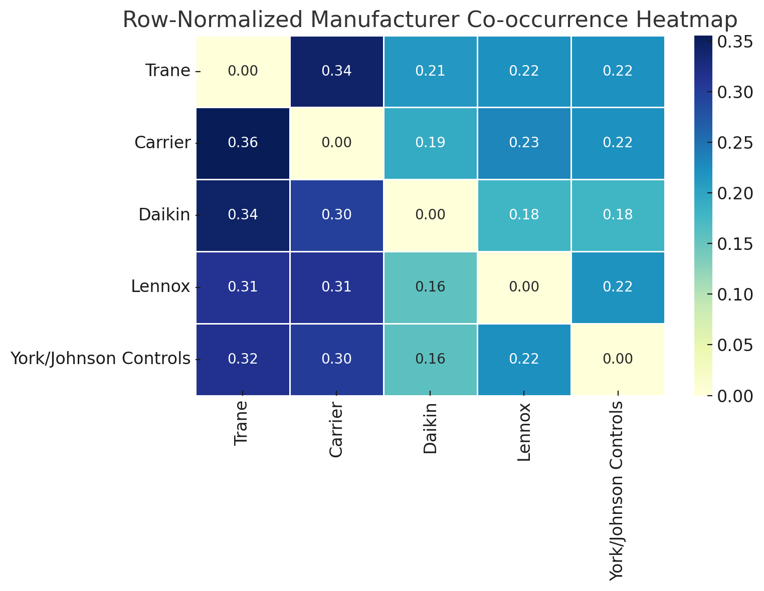
Manufacturer Co-Occurrence (Top 5)
Row-normalized: Shows co-occurrence patterns relative to each manufacturer.
Reveals strong pairings like Trane-Carrier and Daikin-Trane.
Helps identify common manufacturer groupings in spec docs.
Notes:
Adi

Slide 19
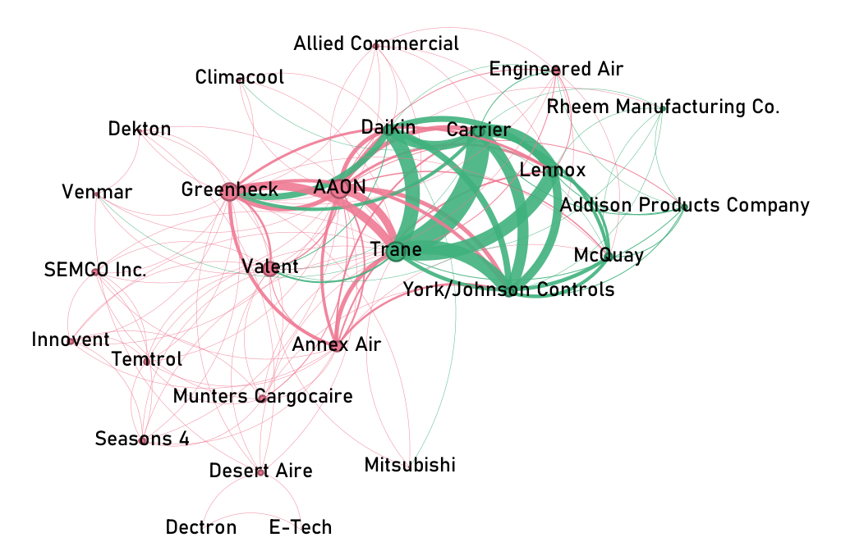
Network View of Co-Occurrence, With Neighborhoods
Community Detection:
Detects neighborhoods where nodes are more connected to each other than to outside nodes.
Pink Neighborhood | Green Neighborhood
AAON | Trane
Greenheck | Carrier
Valent | Lennox
Annex Air | Daikin
Engineered Air | York/Johnson Controls
Munters Cargocaire | McQuay
Innovent | Addison Products Company
SEMCO Inc. | Rheem Manufacturing Co.
Seasons 4
Temtrol
Allied Commercial
Desert Aire
Dekton
Venmar
Climacool
Mitsubishi
Dectron
E-Tech
Notes:
Akshaj

Slide 20
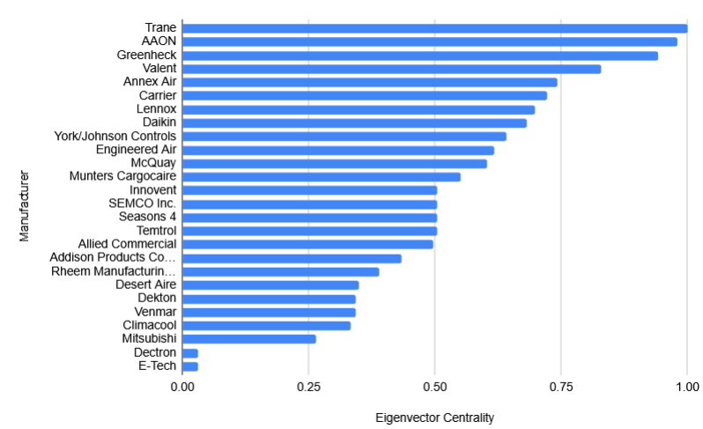
Eigenvector Centrality of Manufacturers
Eigenvector Centrality:
Measures the linked-ness of each node’s neighbors. Can capture nodes with links to few(er), but popular, nodes.
E.g. Valent and Annex Air: Lower absolute frequency (previous slide), but show up alongside more popular alternatives.
Notes:
Akshaj

Slide 21
Wrap-Up
Notes:
Morgan

Slide 22
Wrap-Up
Takeaways
Future Considerations/Caveats
Claude was most performant of LLMs we tested across all stages
Product type identification is tricky with LLMs
LLMs are a promising replacement for existing Boolean search methodology.
Costs of using commercial model like Claude on full corpus: prohibitive?
Experiments with lightweight open-source model, Gemma 3:12b, produced promising results
OCR may present a challenge on the full corpus
Sparse/no existing examples of BOD and Explicitly Excluded labels; full corpus would provide more examples
Notes:
Morgan

Slide 23
Q&A
Notes:
Prof. Alexander

Slide 24
Thank you!
Notes:
Prof. Alexander

